Slide 1



Team Rocket:
Andres Segundo
Brian De Guzman
David Munoz
Ellie Lin
Nick Zhang
7/26/17

Slide 2
Introduction
Rocket Slug is a game to improve children’s math problem solving skills and to make math fun through a competitive aspect.

Slide 3
Goals
Sprint 1
Planned Goals | Achieved? | Reason if not achieved
Get familiar with Android Studio | No | Decided to use Unity instead, so we learned how to use Unity
Implement a simple art design and menu feature to build the framework of the game | No | Spent more time than expected to learn Unity and C#
Notes:
Maybe split into two slides?

Slide 4
Goals
Sprint 2
Planned Goals | Achieved? | Reason if not achieved
Create a main menu so that the player can start the game | Yes
Add character and obstacles so that the player can play the game | Yes
Move the character so the player can dodge obstacles | Yes
Add a moving background so that it looks like the player is moving up | Yes
Notes:
Maybe split into two slides?

Slide 5
Goals
Sprint 3
Planned Goals | Achieved? | Reason if not achieved
Create new objects so that the player can avoid obstacles | Yes
Display math questions so that the player can answer the math problems | Yes
Create collision for obstacles and the player so that the player needs to avoid obstacles | Yes
Notes:
Maybe split into two slides?

Slide 6
Goals
Sprint 3 (Continued)
Planned Goals | Achieved? | Reason if not achieved
Add sound effects and music so the game is more enjoyable | Yes
Add the gas tanks so that the player can play a complete game | Yes
Increase fuel when player answer the math problem correctly | Yes
Test the final product | Yes
Notes:
Maybe split into two slides?

Slide 7
Biggest Challenges
None of the team members had experience with C# before.
It was hard to find meeting time that works for all of us.
We also need to learn how to develop a game in Unity.
Limited Time, first sprint was spent learning and completing tutorials.

Slide 8
Biggest Accomplishments
We were able to achieve most of our goals.
We made one complete level.
Being able to pause the game when the math problem shows up.
Being able to increase the fuel tank when the answer of the math problem is correct.

Slide 9
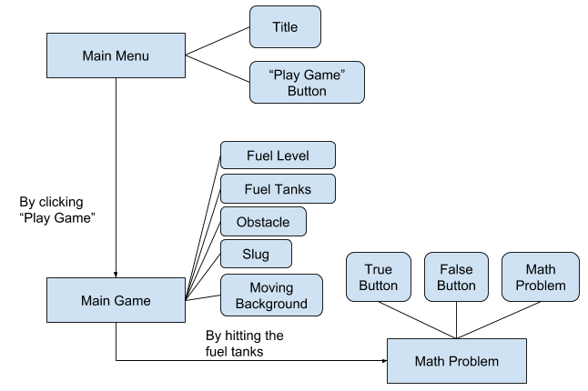
System Overview/Diagram

Slide 10
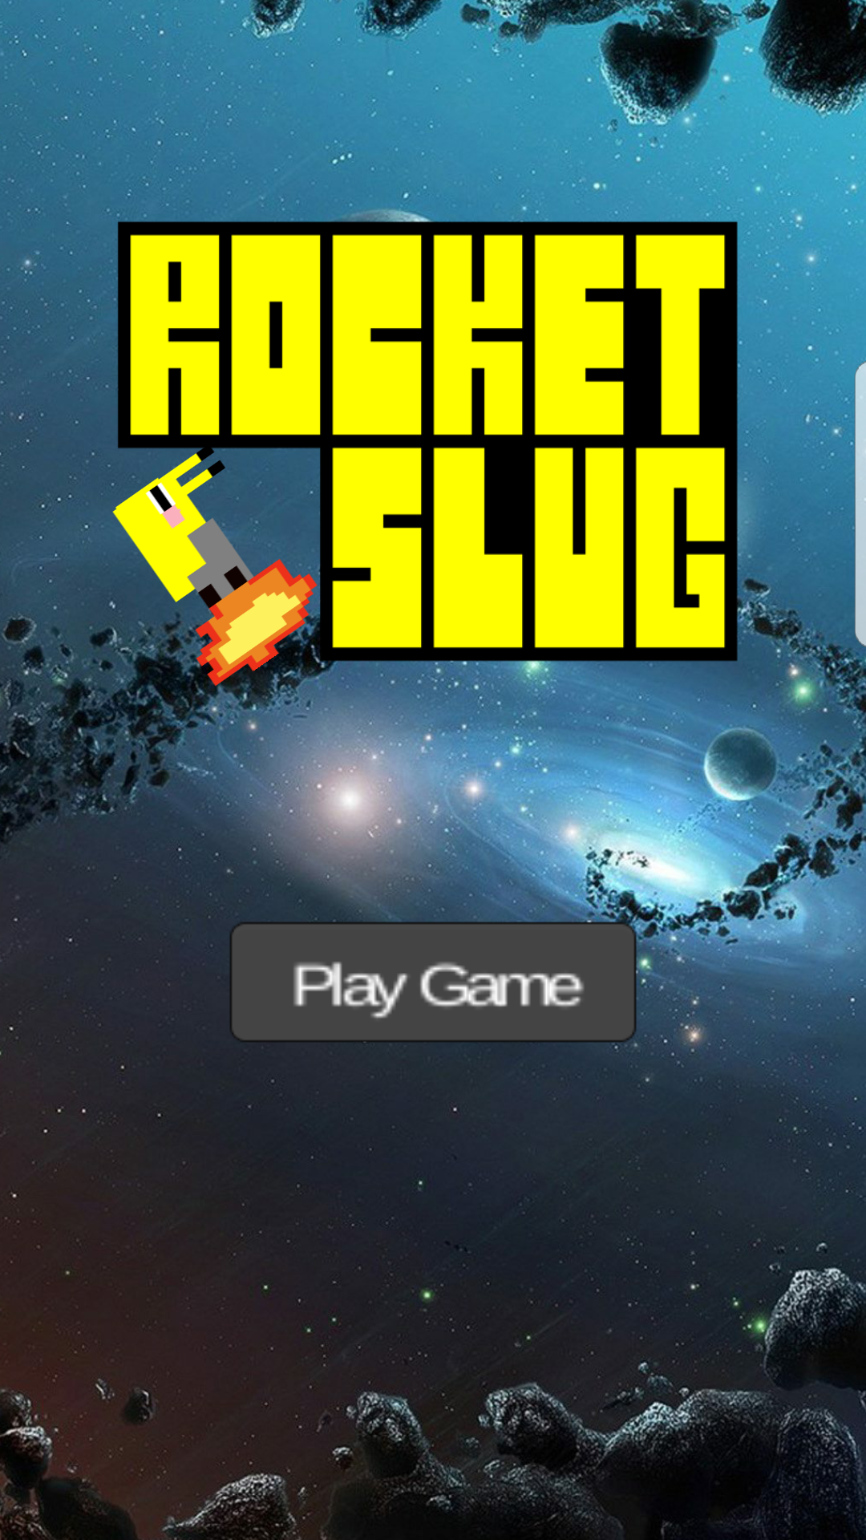
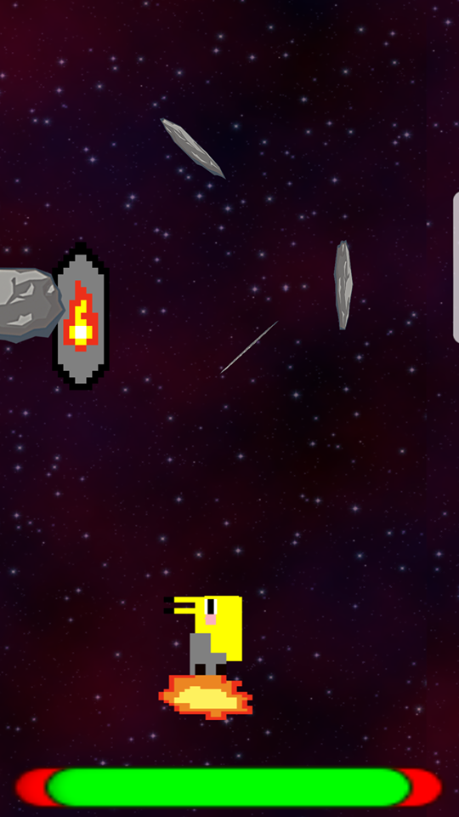
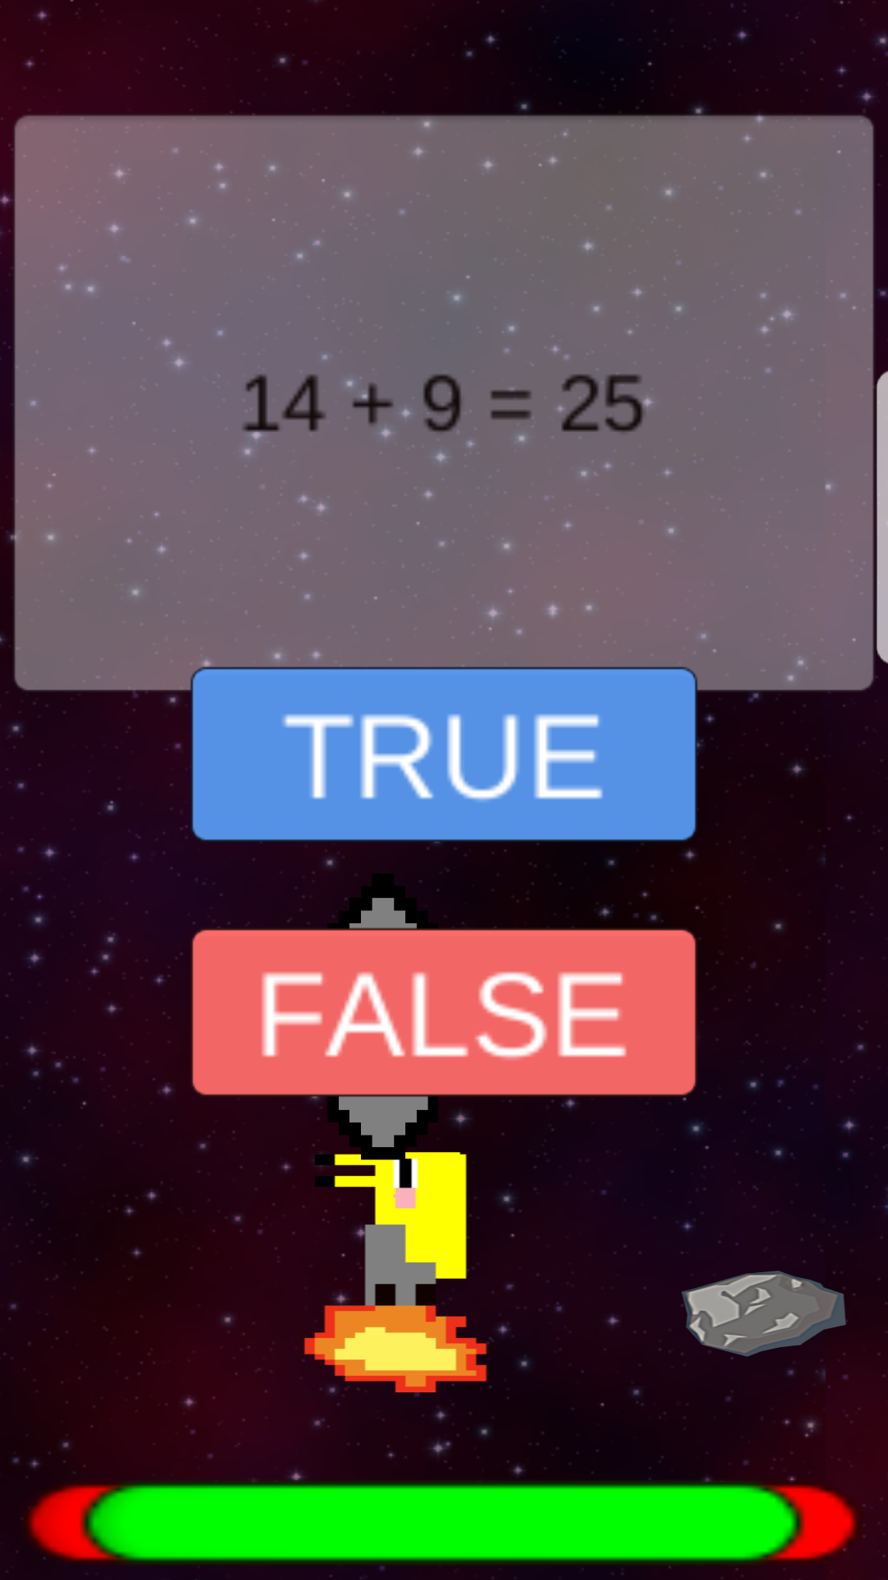
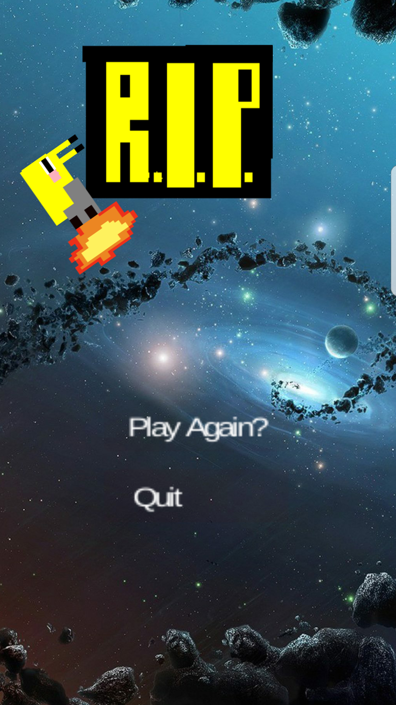
System demo

Slide 11


Technologies
→ Development Platform
→ Programming Language
Make8bitart.com → Image Editor
Mp3 Converter → Audio

Slide 12





Project Management Techniques
→ Scrum Management
→ Document Sharing
→ Development Management
→ Communication

Slide 13
Bugs
Hit detection can be off when there is multiple asteroids on screen
Asteroid and fuel tanks can spawn on top of player and on screen
Asteroid and fuel tanks can spawn outside of the player camera, which means objects can appear cut on the sides of the screen, clipped.
Player can still move during math question scene
Endless background has a visible clip
Slug can be moved to sides to the point where it seems to be slightly off screen

Slide 14
Things we enjoyed/didn’t enjoy
Enjoyed
Got to learn how to be software engineers and develop a game as a team.
Learned how to use Unity and C#
Did not enjoy
It was stressful to finish developing the game within 3 weeks.

Slide 15
Lessons Learned
We learned how to make games in Unity
We learned C#
We learned how to use Scrum practices for project management

Slide 16
Thanks for Listening

